Slide 1
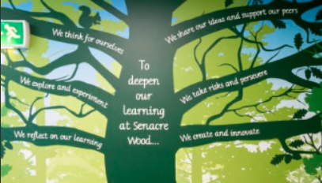
Oak class stay and play 2025
Notes:
Hello, thank you all for coming. Welcome Sarah Norris. Today is an opportunity for you to understand phonics a little bit better, which allows you to support your child at home.

Slide 2



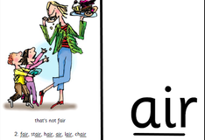
What is phonics, and how it has changed.
Phonics is a way of teaching children how to read and write.
At Senacre Wood, we teach systematic synthetic phonics (SSP) using the Read, Write, Inc. scheme, which links the letters in the alphabet to the sounds they make.
- Single sounds (phonemes)
- Letter groups of 2, making 1 sound
(digraphs/ special friends))
- Letter groups of 3, making 1 sound
(trigraphs)
Our focus in Oak class is to support your child with hearing and identifying the single sounds in the alphabet, which will allow them to begin reading and writing words/ sentences.
Notes:
RWI CARDS
We will begin with a whistle stop tour/ short explanation of what phonics is, and how it has changed. I certainly did not learn to read the same way as your children are.
Since September, we have been making our way through the single sounds of the alphabet. As your child continues on their journey, this will progress into letter groups, then eventually trigraphs and split digraphs, but Mrs Norris will cover that in more detail when they get into Year 1!

Slide 3

Supporting your child at home
You can support your child in many ways with phonics at home. We do not expect you to devote long periods of time in doing so – phonics games are most effective when they are interactive, fun and most importantly, quick!
Phonics hide n’ seek & phonics hunts: hiding sounds (phonemes) on scrap paper OR hide toys and items encouraging them to say the first sound.
Writing labels of sounds on toy cars, blocks, teddies, dollies etc.
Looking for sounds on packages, tins, road signs etc.
Practise writing the letter formation on a plate of flour/ rice.
- Have a look at Seesaw for more suggested activities.
Notes:
We advise that any support at home is a short, fun and engaging activity. Special jobs little and often work well in Oak class! On this slide, there are some suggested activities on different ways to support your child at home.

Slide 4
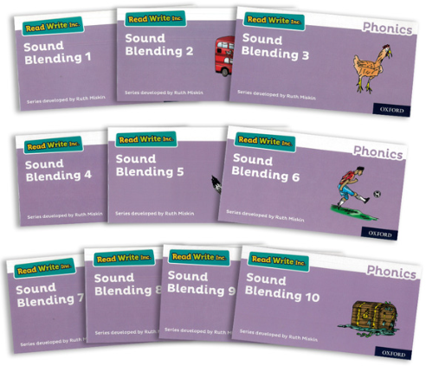
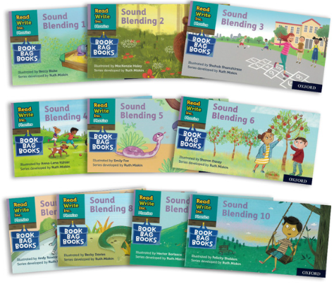
Read, Write, Inc. (RWI) ‘Sound blending books’
A small book which helps consolidate your child’s phonics knowledge – all the phonemes in these books your child would have learnt in school.
Information on how to use the book on the insert page.
Your child will get a RWI book on Mondays which they will keep for the week, and return on Fridays.
New books will not be given out if we are awaiting the previous book. Books that are not returned or damaged will be invoiced at a cost of £4 per book.
Notes:
SOUND BLENDING BOOK, READIND RECORD and FRED
Since the start of term 2, we have been sending home sound blending books. These books are designed to help your child sound blend CVC words. At this stage, if they are not blending independently, then you can step in to and help them to listen to the oral blend. For example, with the word ‘pin’, ask your child to say the sounds they know ‘p-i-n’, which you can repeat, in the hope that they will hear the sounds to then form a word. If they are finding this tricky, then we recommend you oral blend when you can at home (we call this speaking like Fred the Frog!), for example, “Please can you get a c-u-p, or put this in the b-i-n.”

Slide 5
Weekly timetable for RWI sound blending books
Monday | Look at the sounds and words on pages 1-12, giving your child the opportunity to say the sounds, or if able to, blend the word together (p i n – pin)
Tuesday | Look at pages 12-24.
Wednesday | Focus on the first sounds of the words, ask your child to think of other things beginning with that sound. For example, if the word is ‘mat’, m for Mum, monkey, milk etc.
Thursday | Put the word in a simple sentence. For example, if the word is ‘pot’, the sentence could be ‘The pot is hot.’
Notes:
We have created a timetable to keep you busy with the book for the week. This has been stapled into your child’s reading record.

Slide 6


Book corner books
These are the books and stories your child has access to in the classroom.
Book changing will resume as normal for these books. They will be able to choose the book.
Use these books for storytelling, prediction and comprehension. Questioning/ prompts have been uploaded onto Seesaw.
Please return these books in the condition you find them in.
Notes:
Alongside this, your child will still select a book from the classroom. These books are to be shared together at home, rather than your child reading it, for example before going to sleep.

Slide 7

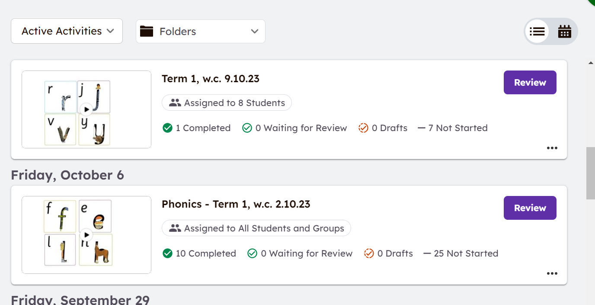
Please continue to support your child with their phonemes (sounds!). All sounds (phonemes!) that your child has learnt in school are on Seesaw.
Notes:
All sounds have been uploaded onto Seesaw. Please visit RWI website for additional guidance.

Slide 8

RWI ditty
Notes:
DITTY
That is the books, however we are going to give you more information about the next step up from the sound blending books. These are called ditties, and if you have a child in KS1 at Senacre, then you will be familiar with these very exciting looking laminates!

Slide 9
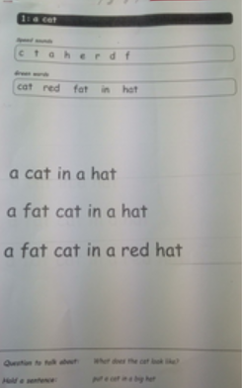
Ditty explained
A ditty is a resource made by Read, Write, Inc (RWI) which is to support children with blending words, and reading simple sentences.
If your child is in the ditty phonics group, they will be using the ditty in school with a teacher.
Notes:
This is the step in between the sound blending books, and the RWI Books, which they will get once they are secure in the ditties. It is to introduce the children to reading simple sentences, that consolidate their phonics knowledge. They will also be used in phonics sessions, if your child is working at the level.

Slide 10
Support at home
Alongside their RWI sound blending books, your child will have a ditty to practise. The books are kept for the whole week.
The ditty will have a label on it, stating when it should be returned. Your child will be working through the ditties for a couple of weeks. In some cases, ditties are repeated. Ditties are used to help build up fluency when reading.

Slide 11
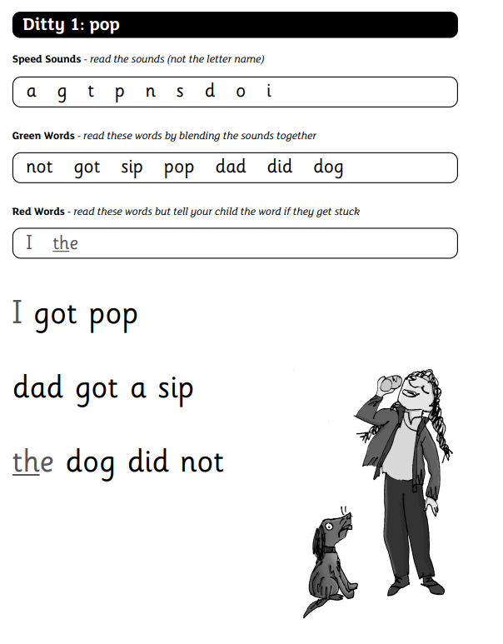
Support at home
Speed sounds
Ask your child to say the sounds in the first section.
Green words
Ask your child to sound-blend the words in the second section.
(m-a-t)
Red words (on some ditties)
These are words that cannot be phonologically blended, we call them tricky words.

Slide 12
Support at home
Sentences (e.g. sit on a mat)
Ask your child to sound-blend the words in the sentences in the third section. Then read the sentence back to them.
Question at the bottom
This is a comprehension check. Ask them the question and then get them to repeat the sentence at the bottom.
Notes:
I am going to pass onto Mrs Norris now, who would like to speak to you about reading at home. After Mrs Norris has spoken, we will bring the children in so they can share their phonics knowledge with you.

Slide 13


Reading at home

Slide 14


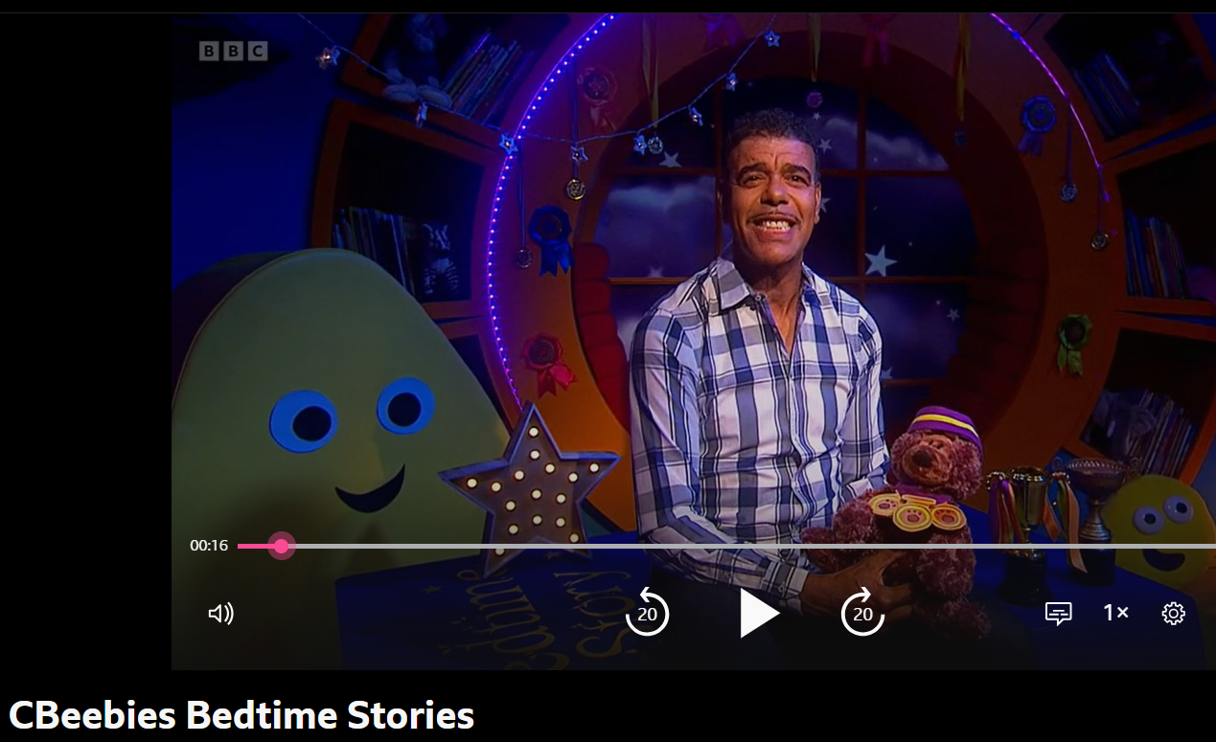
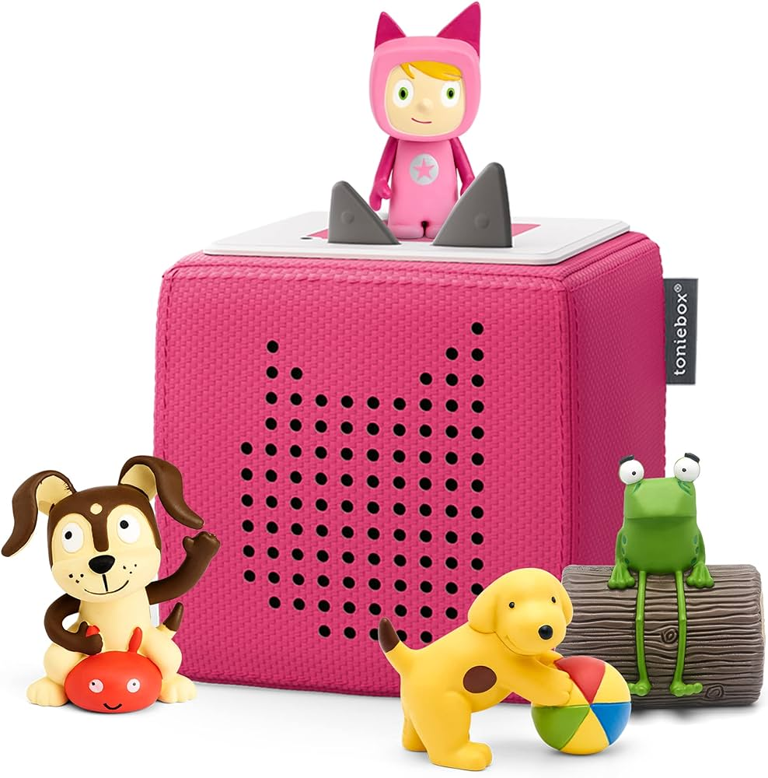
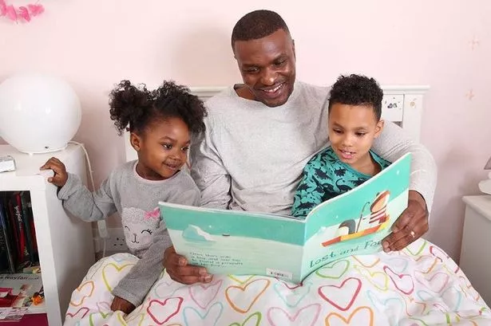

Slide 15

Why read at home?
Reading at home helps the children to consolidate the knowledge that they gain when in school
It gives you, as a parent, a clear understanding of how your child is getting on with their reading
Reading or being read to increases the amount of vocabulary
Reading with your child gives them special, uninterrupted time with you where they can build their confidence
Notes:
Add in class teacher and TA

Slide 16
A few tips and tricks to take away with you:

Slide 17
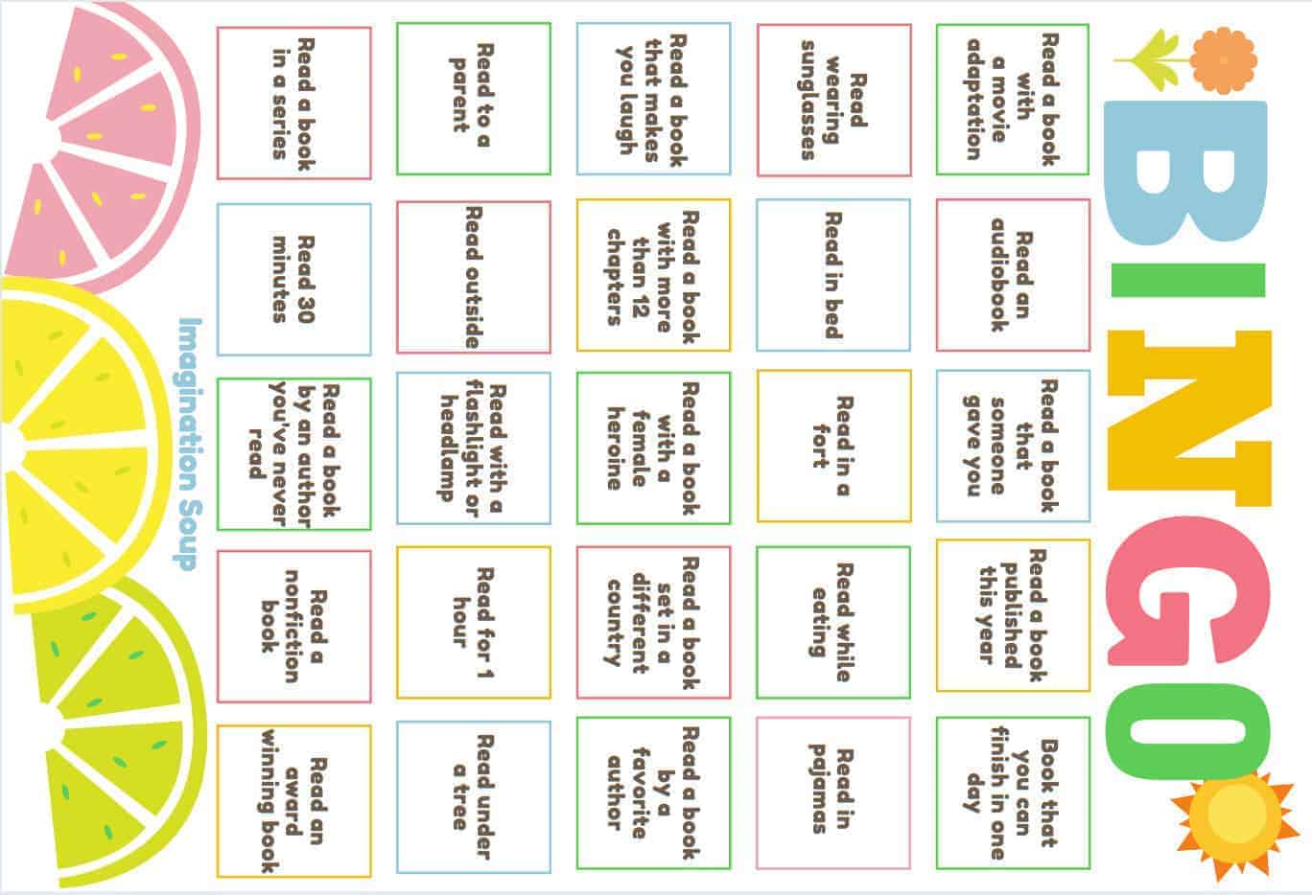

Slide 18
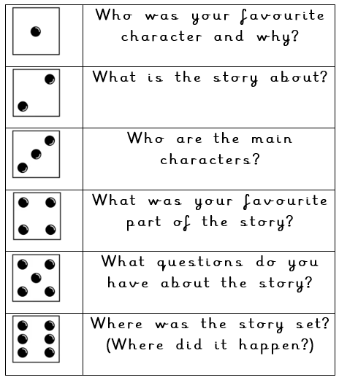

Slide 19


Slide 20
Please come and find us if you have any questions or we can offer any further support.

Slide 21
Time to invite in the children – AKA the experts!

